Slide 1
Samad, Guandong, and Tyler
Brain Stimulator Progress Update

Slide 2
Problem Description
Make a device that can generate waveforms of precise frequency and current to stimulate deep parts of the brain using electrodes.

Slide 3
Timeline Overview
Simulate/create key circuits to verify correct function
Source components and make symbols
Create schematics and layout PCB
Design code for use with microcontroller
Create plastic housing for PCB and 3D print
Verify PCB and redesign
(If time) Make an app to be associated with the unit

Slide 4
Key Considerations – Part I
How can independent signals be isolated from each other?
Separate grounds
Completely isolated power supplies
Or:
Transformers on the output

Slide 5
Key Considerations – Part II
How can frequency and current be precisely controlled?
Use a DDS to remove the need for the microcontroller to operate at a specific frequency. This also frees up more space to calculate current change
Use a voltage controlled current source as shown on the next slide to achieve boost in voltage driving and precise current

Slide 6
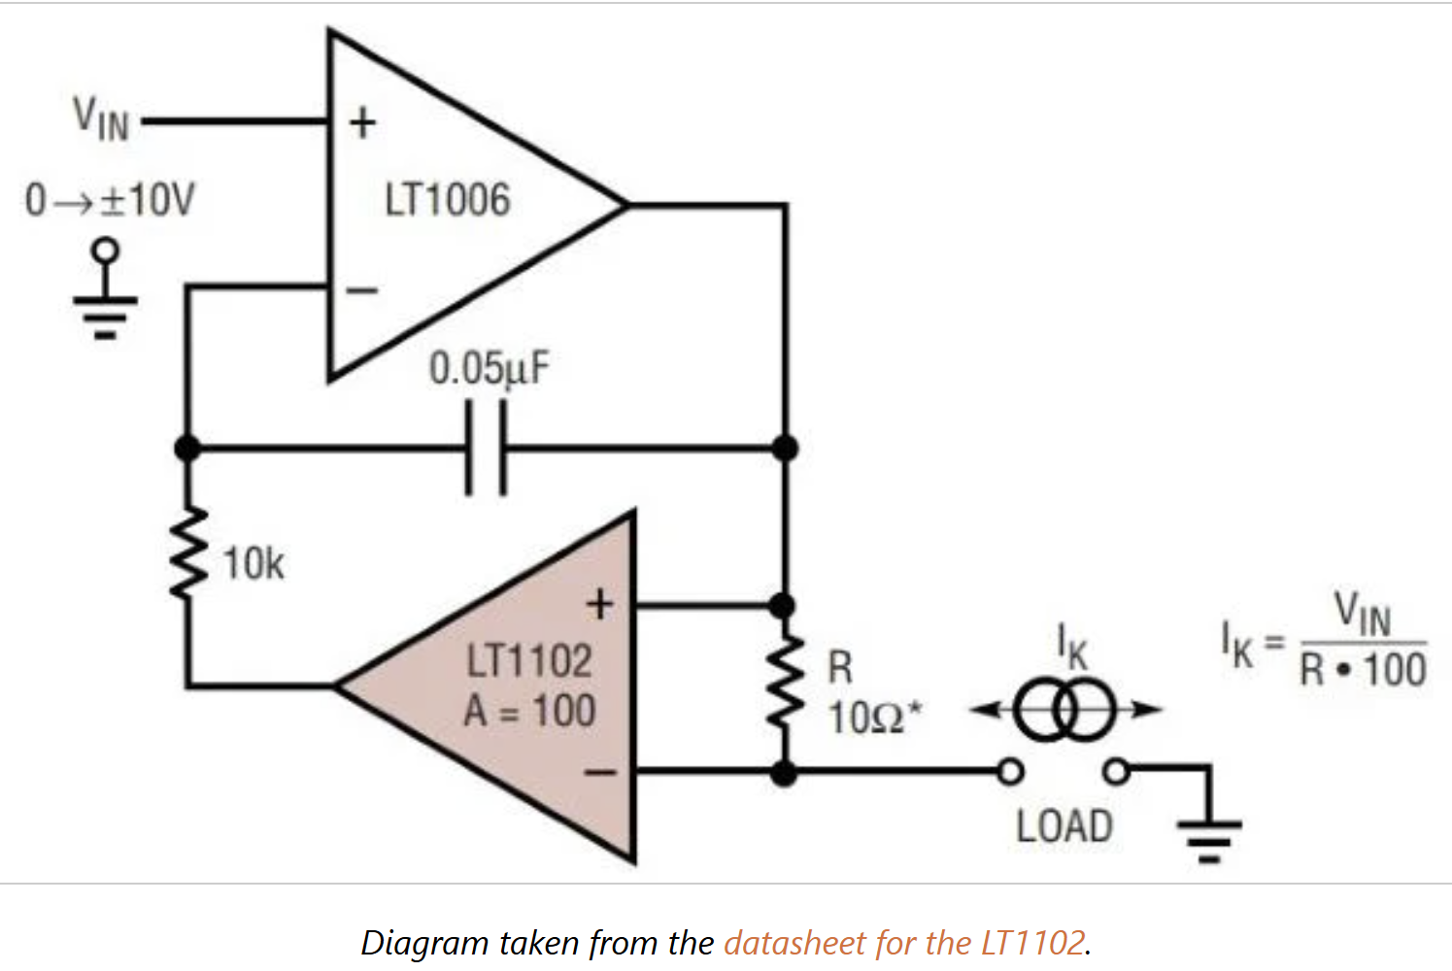
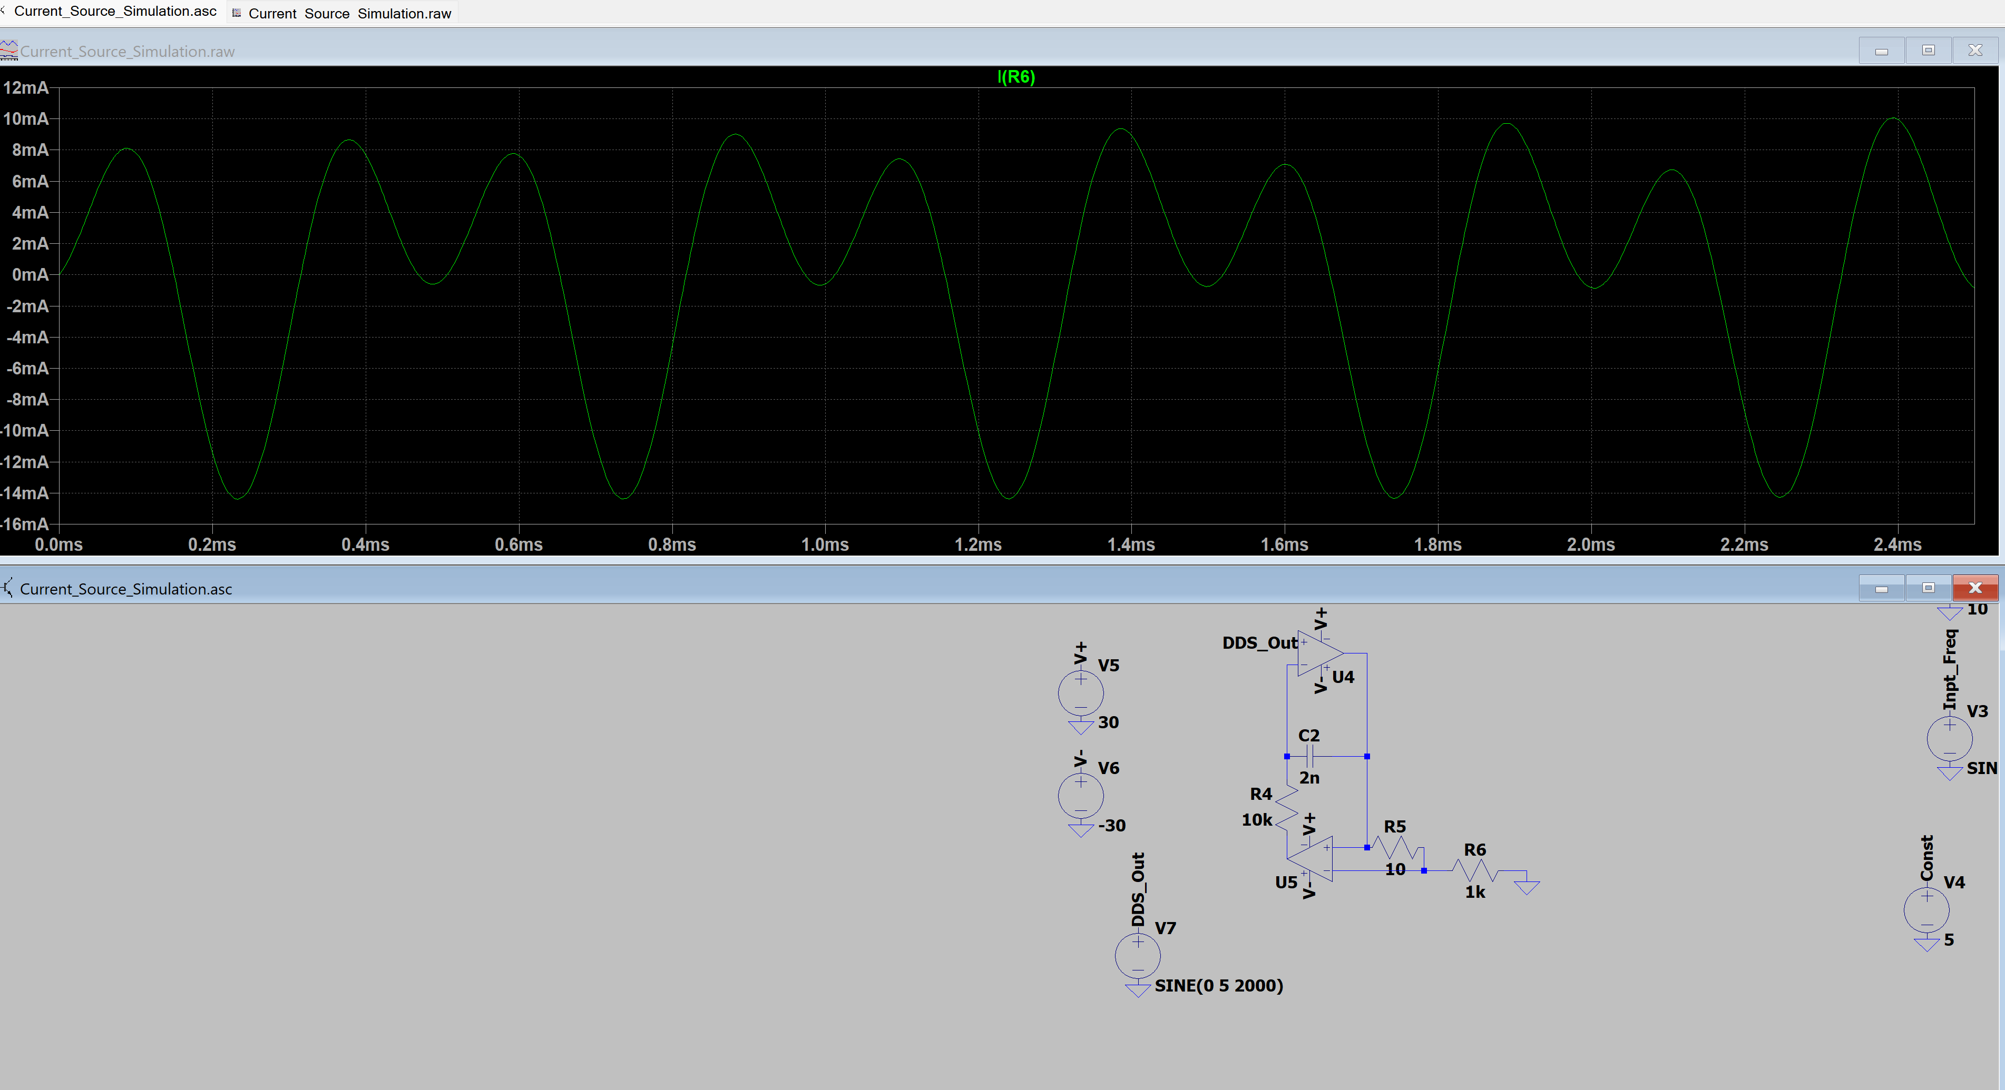
Voltage Controlled Current Source
Based on design by Jim Williams
How to Design a Simple, Voltage-Controlled, Bidirectional Current Source - Technical Articles

Slide 7
Key Considerations – Part III
How do we make the device easy to use?
Have both a hard and soft kill switch
Indicator LEDs
Programmable via app or USB
Limited controls on board such that once programmed the user need only turn the device on and off

Slide 8
Key Considerations – Part III Continued
How do we make the device easy to use?
Potentially use a common microcontroller so that people unfamiliar with device drivers can quickly create programs (For example, Arduino)
Make the casing useful. Potentially add a belt clip and make it handheld and portable

Slide 9
Key Considerations – Part IV
How do we make the device safe?
As mentioned, use isolation
Make different switches different levels of accessible
Set a maximum voltage rail to rail
Potentially use adjustable switching regulator

Slide 10
Component Selection, Part I
Isolation:
Communicate using SPI so that DDS can be updated at high speeds and SPI isolator/redriver can be used
Tradeoffs of using switching converters at the front vs transformers at the back

Slide 11
Component Selection, Part II
Availability:
Team at Indiana should be able to swap parts out easily to modify
Use standard packages and only components that are active and have large amount of stock

Slide 12
Component Selection, Part III
Cost:
The overall product should be as cheap as possible, so find components that do the job without being overly expensive
Don’t over spec. Aim to meet requirements and provide room for functionality expansion without taking only state-of-the-art components

Slide 13
Bill of Materials

Slide 14
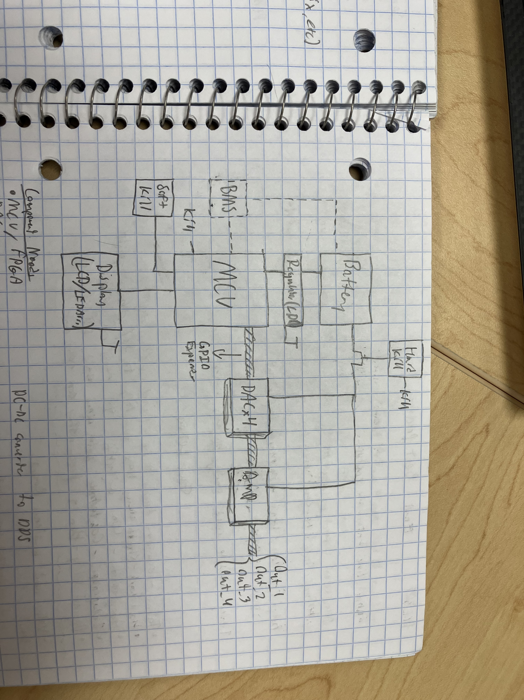
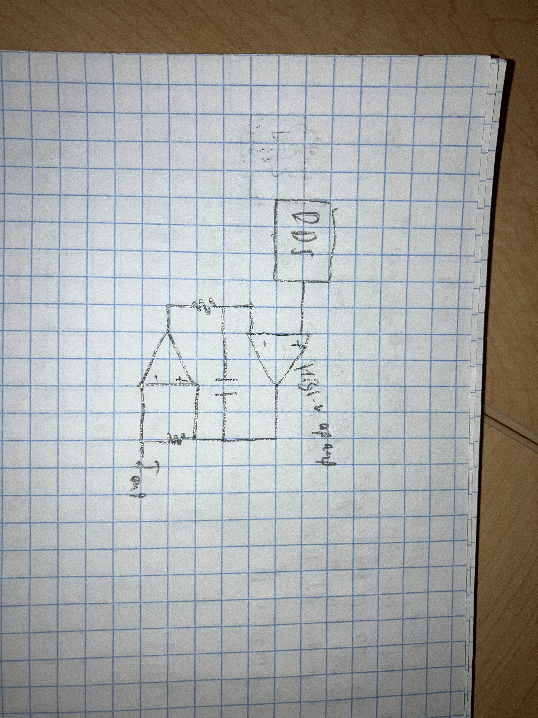
High-Level Circuit

Slide 15
Immediate Plan
Continue schematic and symbol creation
Find components for Jim Williams source that handle high voltage and simulate
Put together physical circuit implementing Jim Williams current source
Determine board measurements for housing

Slide 16
Challenges so far
Determining where to isolate from
Getting current source to work in simulation
Finding MCU with Bluetooth capabilites

Slide 17
Questions/Feedback

